Slide 1
MICROSERVICE SECURITY
Cathal, Thomas & Tom

Slide 2
OUTLINE
What Are Microservices?
Why Use Microservices?
Security Implications of Microservices Architecture
Common Microservice Security Practices
Key Takeaways
Notes:
What
Why
Security implications

Slide 3
WHAT IS A
MICROSERVICE?
A design architecture of an application made from many smaller applications
Each application runs independently and provides a smaller set of functions
Notes:
E.g. amazon

Slide 4
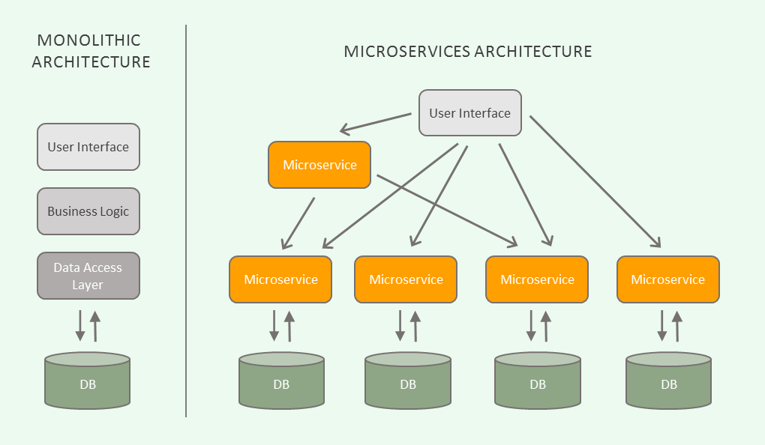
MONOLITHIC VS MICROSERVICES
Source: https://blog.algorithmia.com/introduction-to-microservices/
Notes:
Usually implemented with libraries such as spring, django, asp.net for communication over html orsockets

Slide 5
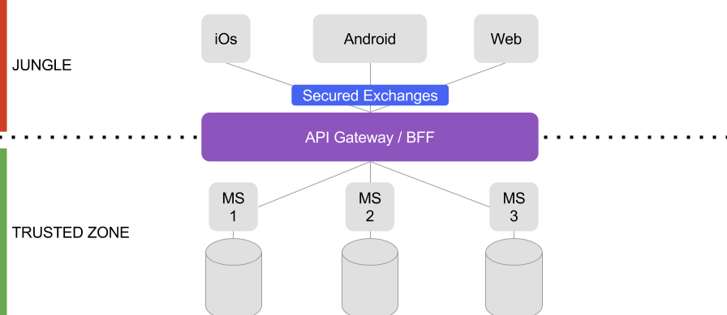
SEPARATION OF LAYERS [4]
Notes:
trusted zone: where exchanges can be done easily with few restrictions.
jungle: we don’t know what can happen and we have to do more efforts on security, particularly on exchanges between clients and gateways.

Slide 6
WHY USE
MICROSERVICES?
Improved scalability, cloud-ready
Easier code maintenance
Decoupled development
Faster feature cycle

Slide 7
MICROSERVICES INHERENT SECURITY BENEFITS
Backend data stores don’t have to be exposed to the internet
Microservices only have access to the data and services they require
Isolation of microservices without breaking functionality
[4]
*ASSUMING A REASONABLY PLANNED MICROSERVICES ARCHITECTURE
Notes:
Access through an api

Slide 8
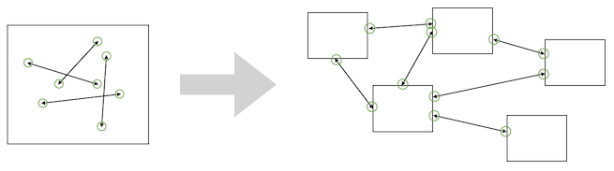
MICROSERVICES SECURITY CHALLENGES
Many Small Services vs Monolith
Exposed API’s vs Internal Method Calls
Multiple Technologies vs Single or Few Technologies
[1]
Notes:
Microservices do present some of their own security challenges versus a monolithic program. Here are just a few
Microservices are obviously comprised of many small services vs the single monolith program. This means that each individual service must be made secure rather than only requiring handling security of the overall program
With microservices, each services exposes its own APIs to be used either by a user or by another service, compared to internal method calls in a monolith program. It must be ensured these APIs cannot be called by those who shouldn’t have access to them and can’t be called with malicious intent. For example, with internal methods, returning a long list of objects can be simply done by returning a pointer, with microservices, these objects must be serialised and sent over the network, opening the possibility of a denial of service type vulnerability.
Building an application with microservices means it will likely be composed of many different technologies, or even versions of the same technology. Compared to a monolith application which would probably comprised of a few different languages, a microservice allows every service to be made from a different language, and even if rules are imposed on the languages and technologies used, services will likely be written with different versions based on when they were built. This makes it much harder to keep track of all the known vulnerabilities of every bit of technology used by all the services making up an application.

Slide 9
SECURITY PRACTICES

Slide 10
AUTHENTICATION & AUTHORIZATION
Authentication: Who you are
Authorization: What you can do
OAuth2³ is an industry-standard protocol for authentication and authorization
A protocol such as OAuth2 or similar should be used to save on development time & reinventing the wheel
This is used to secure endpoints in the web app

Slide 11
CERTIFICATES
Certificates provide a guarantee of the authenticity of the server
If an attacker were to compromise a certificate, the target website / server could be impersonated
Could lead to the exposure of sensitive user data
Rotation of certificates reduces the chances that the certificate which an attacker compromises is valid

Slide 12
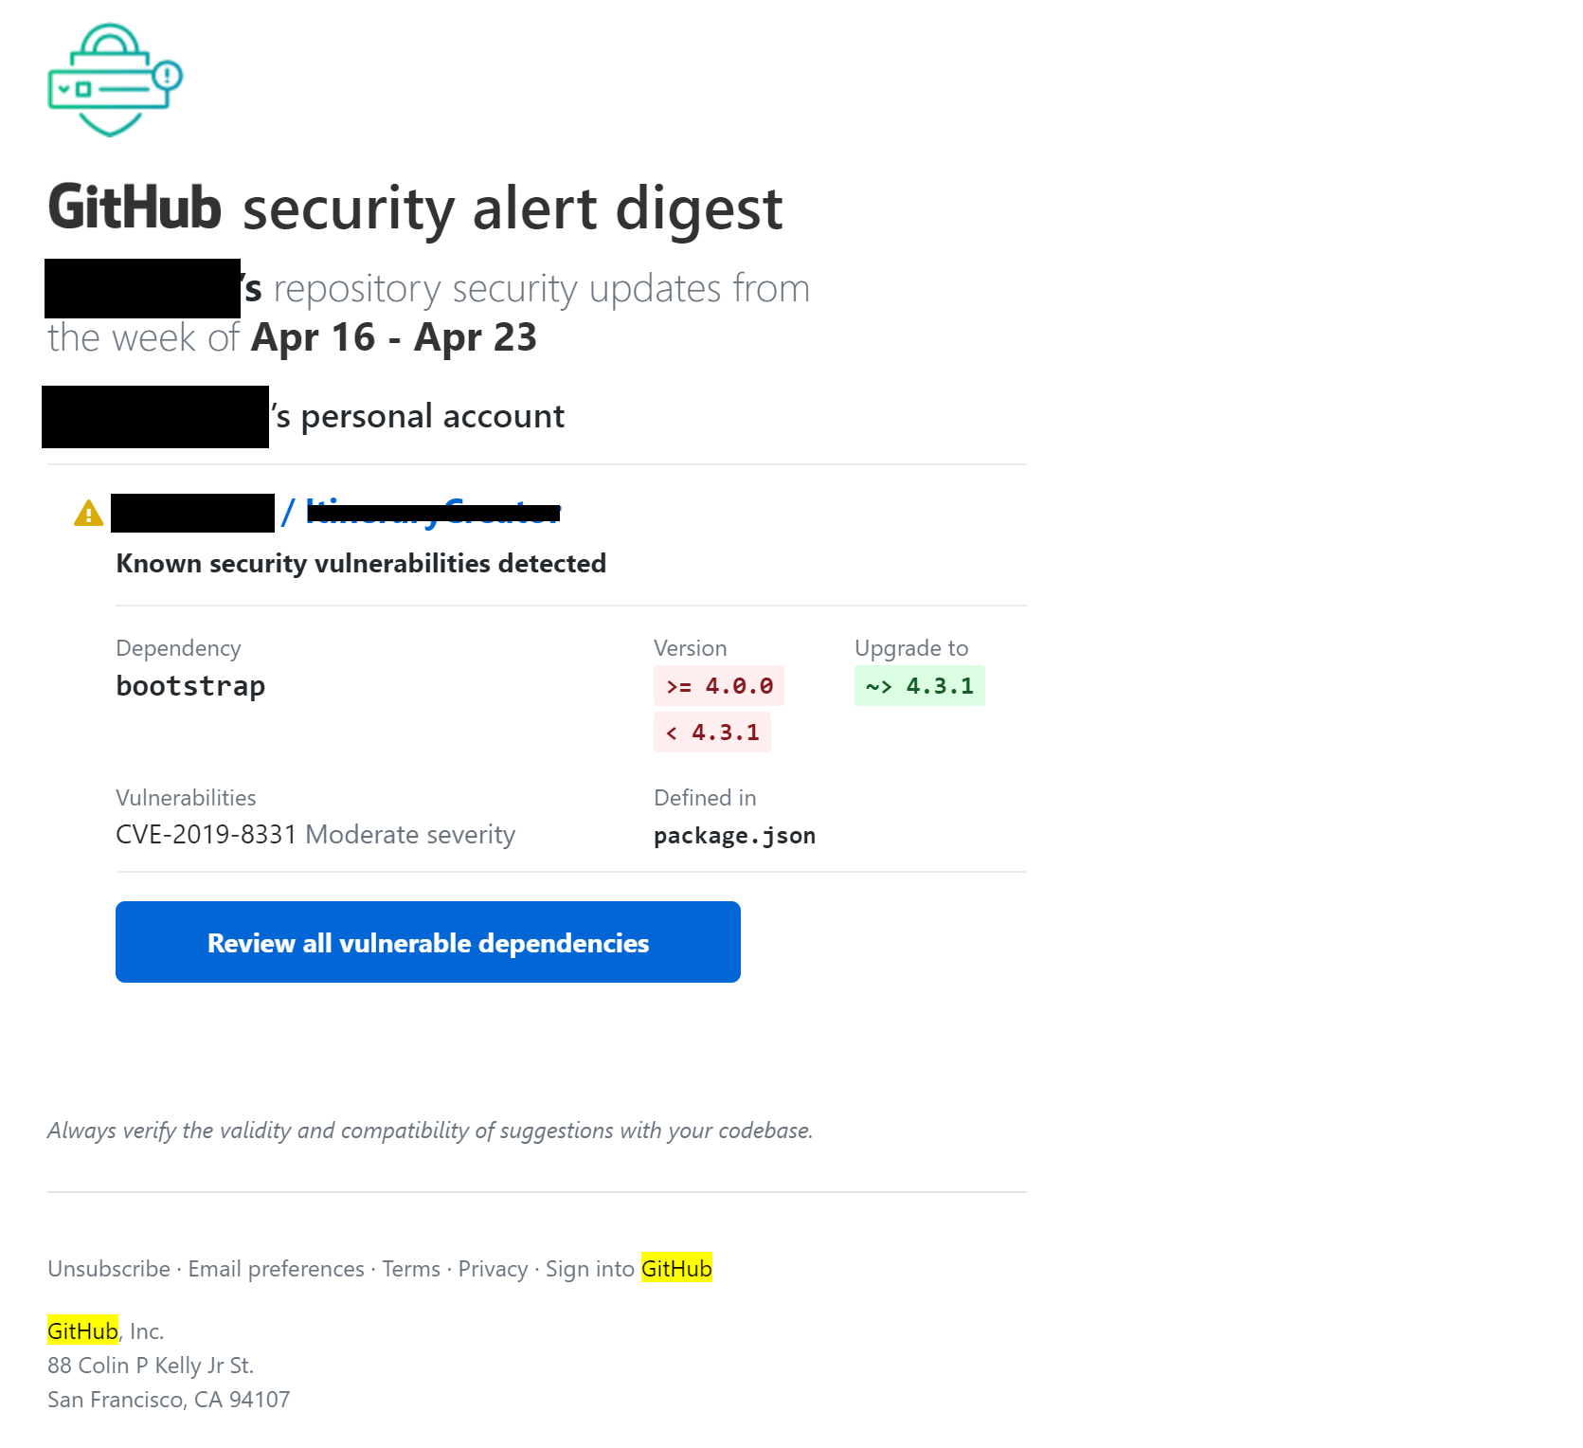
KEEP PACKAGES & LIBRARIES UP TO DATE
Microservices result in multiple technologies and versions
Github security alerts
Node Package Manager (NPM)
Notes:
Because microservices are likely to have many more technologies and versions, it is a good idea to ensure everything is always up to date to try limit the number of technologies
Node package manager manages your node dependencies and when installing them tells you about known security vulnerabilities

Slide 13



THIRD PARTY HELP & DEPLOYMENT
Notes:
Each of the popular cloud services provides an environment in which microservices can be developed. Using these allows all the security benefits of running an application through them. They provide monitoring for individual microservices and access logging. They also provide secure connections and communication between each microservice

Slide 14

THIRD PARTY HELP & DEPLOYMENT
[2]
Notes:
Istio is another service created by google and IBM. Among other things it provides easy to use security features specifically for microservices. Istio allows you to configure role based access control outside of the code of the microservices. Istio handles all authentication including key management and provides secure communication both between services and between users and a service

Slide 15

SPRING SECURITY & OWASP JAVA ENCODER PROJECT
Authentication & Authorisation
Security Filters
Secure Individual Methods
Prevent Cross Site Scripting
Notes:
Spring has built in methods to provide authentication and authorisation services to web applications. Filter chains are used to check authorisation, either letting the user hit the intended servlet, redirecting them to authorisation entry point (eg a login page) or throw a security exception. Spring also allows you to secure individual methods in a service, placing authorisation requirements on the method. Thus a call to that method will cause authorisation to be checked, and may return an access denied exception

Slide 16
DEFENSE IN DEPTH
Services handling sensitive data should be secured with a combination of cryptographic and other security systems
Ensures confidentiality and integrity of user data
Examples of security components which can be layered
Firewalls
Intrusion Detection Systems
Physical Security
Ensure strong passwords
Use HTTPS
Notes:
Authentication means verifying that someone is indeed who they claim to be. Authorization means deciding which resources a certain user should be able to access, and what they should be allowed to do with those resources

Slide 17
TESTING
As with any application testing is an important part of the development process.
Unit Testing
Integration Testing
End to End Testing
Penetration Testing
Test the application in many different scenarios.

Slide 18
KEY TAKEAWAYS
DON’T REINVENT THE WHEEL!
DO SECURITY UPDATES!
DO TEST YOUR CODE!

Slide 19
References
[1] https://container-solutions.com/security-challenges-in-microservice-implementations/ [2] https://cloud.google.com/istio/
[3] https://oauth.net/2/
[4] https://medium.com/@maximethomas_46287/secure-a-microservices-architecture-9f148c4f3b5e [5] https://spring.io/guides/topicals/spring-security-architecture

Slide 20
ANY QUESTIONS?

